Slide 1
Age UK Cambridgeshire and Peterborough is an independent charity which is part of the Age UK Brand Partnership
www.ageukcap.org.uk
Registered charity number 1165856
Notes:
Age Concern was formed many years ago after the second world war as part of a collaboration of groups, for older people at a time when older people seemed to be overlooked compared to other cohorts in society.
In 2010 Age Concern's Cambridgeshire and Peterborough were one of the first adopters of the Age UK brand, this was following the merger of Age Concern and Help The Aged. Then in 2016 Cambridgeshire and Peterborough merged to form Age UK Cambridgeshire and Peterborough, continuing to be a local independent, albeit slightly larger independent charity.

Slide 2
We're a local charity working in the community to support older people, their families and carers.
www.ageukcap.org.uk
Registered charity number 1165856
Notes:
In 2019.20 we supported in excess of 26,000 older people, including their family and carers. We know this number will be much greater following the extremely busy year we have had during the pandemic. Whilst it has been difficult we are for the first time pleased that older people appear to have greater recognition for the value they can bring to society but also how older age can bring it's challenges. We wish to build upon this, creating a sustainable future for the organisation so we are here for the long term whilst our older population continues to grow.
In addition to service delivery we lobby with and on behalf of older people on matters such as Health and Social Care Integration, Free TV Licences and raise vitak funds through campagins such as Innocent Smoothie hats

Slide 3
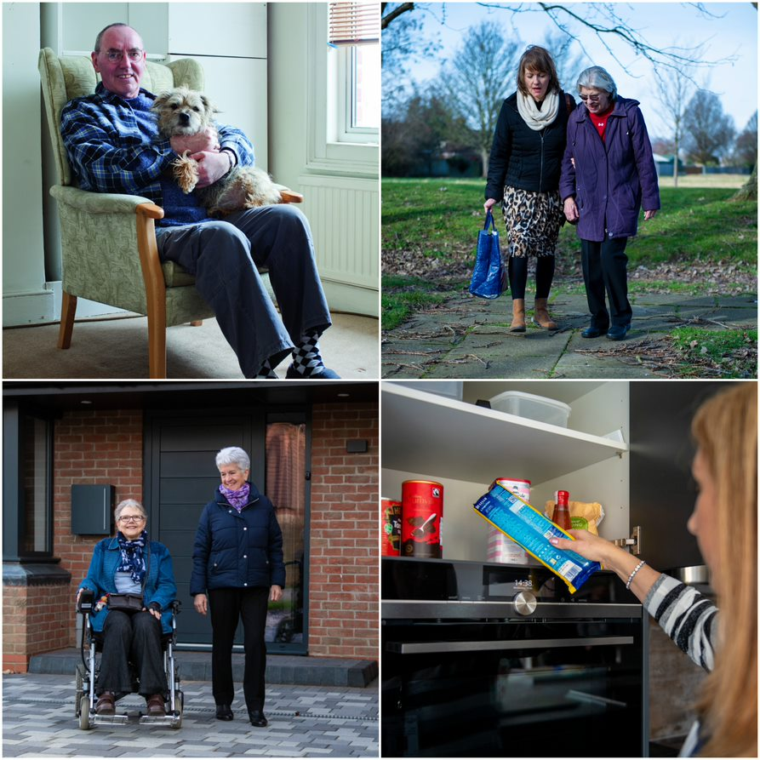
We help older people to live independently in their own home
www.ageukcap.org.uk
Registered charity number 1165856
Notes:
Most older people tell us they wish to live at home independently and by providing support and interventions through various services we help to make this possible. By offering such support we help to delay or prevent the need for statutory interventions, including home care, residential and nursing accommodation and hospital admissions.
The services we offer fall into 3 specific categories:
Information and Advice
Practical
Social and emotional

Slide 4
We give confidential FREE information and advice
Maximising your income
Debt management
Care choices
Health and Wellbeing /Disability aids and support
Transport
Leisure – what’s going on where you live?
www.ageukcap.org.uk
Registered charity number 1165856
Notes:
Including information and advice covering Welfare Benefits, access to grants, managing finances, housing issues, understanding care, access to social activities delivered not only by ourselves but also by other partners.
Our Helpline is open 365 days per year and primarily a called will speak to a local Information Officer or at times when our local lines are closed, callers cam then speak to the National Helpline which is part of our Brand Partnership with Age UK.
For more complex case work we have a contract with the local authority to deliver 1:1 support for the longer term, until situations are resolved, these may be around bereavement, decline in health, significant financial difficulties

Slide 5
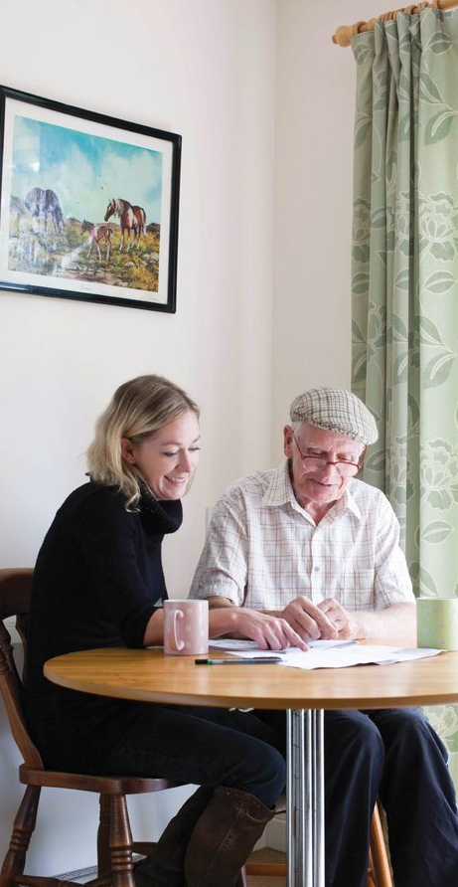
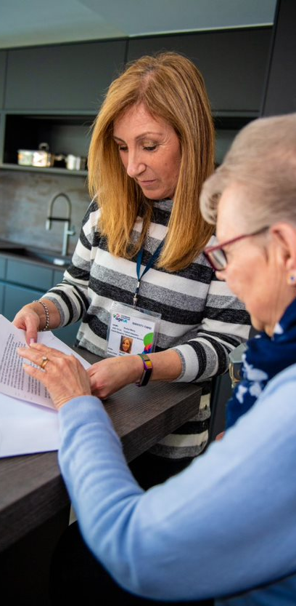
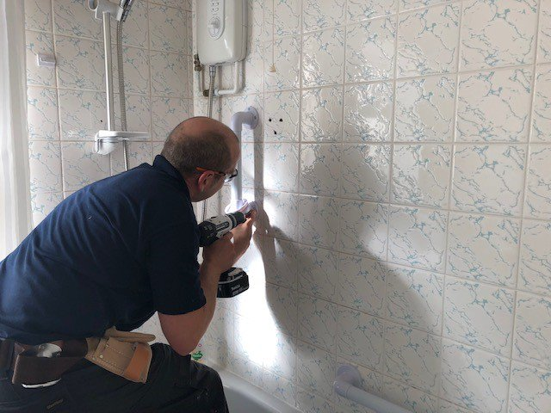
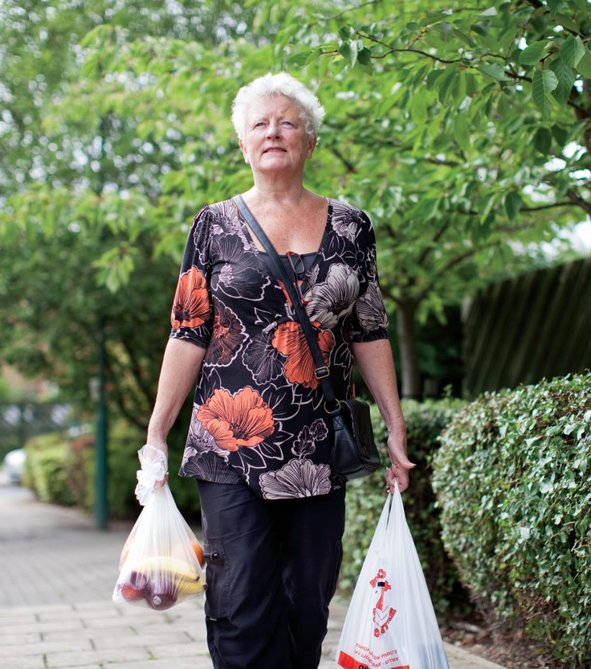
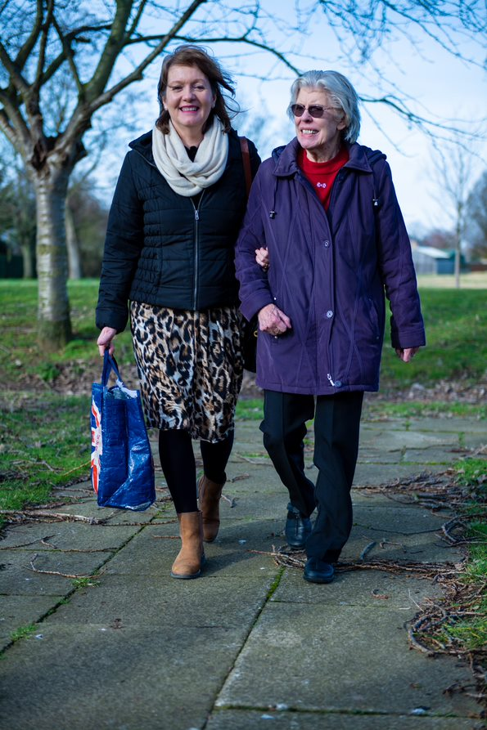
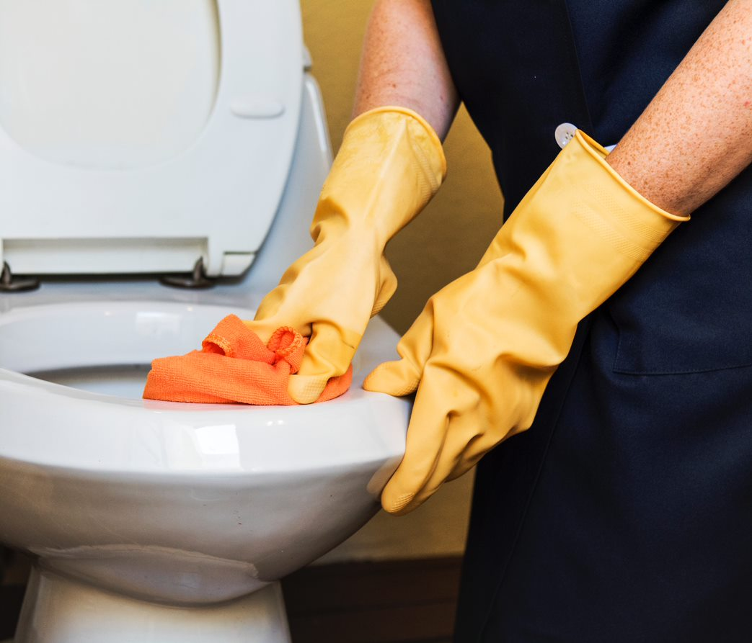
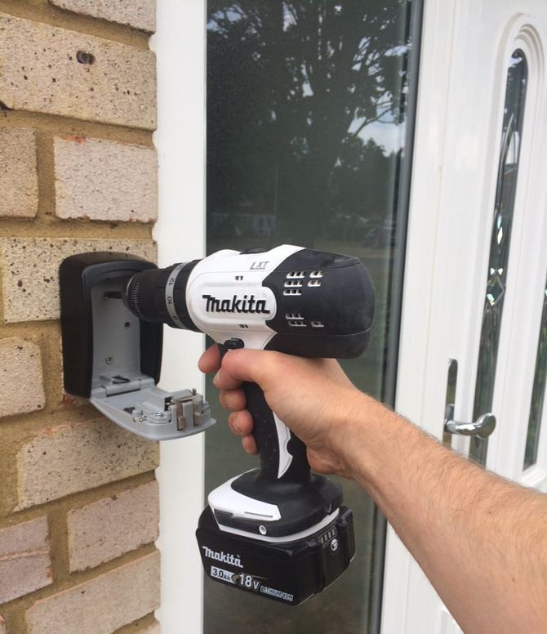
PRACTICAL HELP
We can help with:
Shopping
Cleaning/Housework
Handyperson/small DIY jobs
Life admin/ paperwork/ sorting and reading post
Support at difficult times: moving home, bereavement
www.ageukcap.org.uk
Registered charity number 1165856
Notes:
Our Practical Services support older people to remain safe and well at home. Through our Handyperson Service work closely with therapy services to deliver home and wellbeing assessments , reducing falls and generally enabling older people to have more confidence and independence in their own familiar settings. We install keysafes, grab rails, galvanised rails, half steps and more: plus we carry out small jobs around the home such as hanging pictures and curtains and laying slabs, all of which helps people to enjoy their home whilst avoiding accidents which can be caused by doing such jobs if you are physically less able.
Our community wardens help many older people with small tasks and giving general peace of mind whilst our Home Support Workers help with cleaning and general household chores as well as being a consistent in the lives of many individuals, recognising any concerns or decline in the wellbeing of service users.
The Cambridge South Warden Scheme, which includes Sawston is still in its’ infancy but we are pleased to note 10 service users live in Sawston. We appreciate the support you can give to the promotion of the service

Slide 6
Supporting friendships through Sharing Time and Telephone Befriending
www.ageukcap.org.uk
Registered charity number 1165856
Notes:
Our Sharing Time Service carries this name as it highlights the value to both parties engaged in the friendship formed, not doing to, instead creating an equal bond.
During the pandemic we launched a Telephone based specific Befriending service which has been so well received, and has given often isolated individuals the opportunity to volunteer for us – it is our intention to continue this long term

Slide 7
Day Services and Friendship Clubs
www.ageukcap.org.uk
Registered charity number 1165856
Notes:
We offer six day services across the county, one of which is based here, and dare I say, is an integral part of the Oasis Centre. The centre are very welcoming to the club and whilst some service users travel a few miles to the provision, a number actually live very close by. This type of intervention provides social and emotional support, forms friendship and gives some carers, often older people themselves, much needed respite – the centres are happy places which are very much user led and developed. Currently due to Covid restrictions we can only offer half capacity so for those who usually attended twice a week this has had to be reduced temporarily. During the full lockdowns the centres were closed but staff and volunteers ensured the health and wellbeing of service users was monitored by carrying out doorstep visits and making regular phone calls.
Our Friendship Clubs are community provisions which we support the set up of, empowering local communities and volunteers to lead within their own areas. We then continue the support, including offering training and stepping in leadership is short. This model fits extremely well with the Think Communities approach.

Slide 8
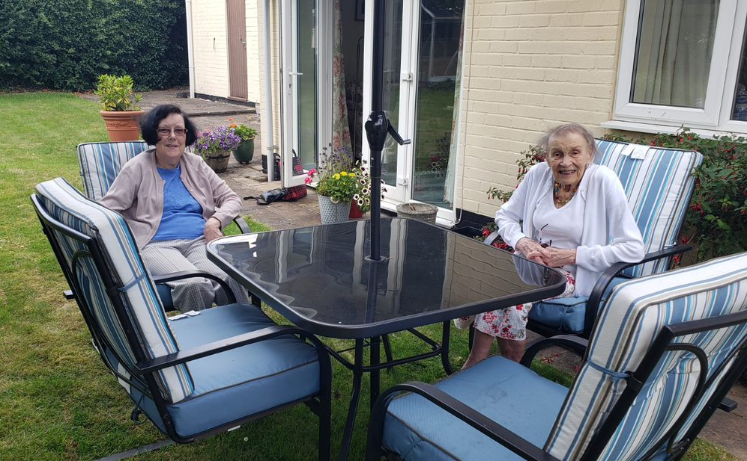
Volunteering
It’s a great way to:
meet new people
share your interests
learn new things
proven health benefits
www.ageukcap.org.uk
Registered charity number 1165856
Notes:
We wouldn't be the organisation we are without our nearly 500 volunteers, they enable to reach more older people and provide us with many skills whilst learning more through their volunteering.
However we always need new volunteers to support our growing demand

Slide 9
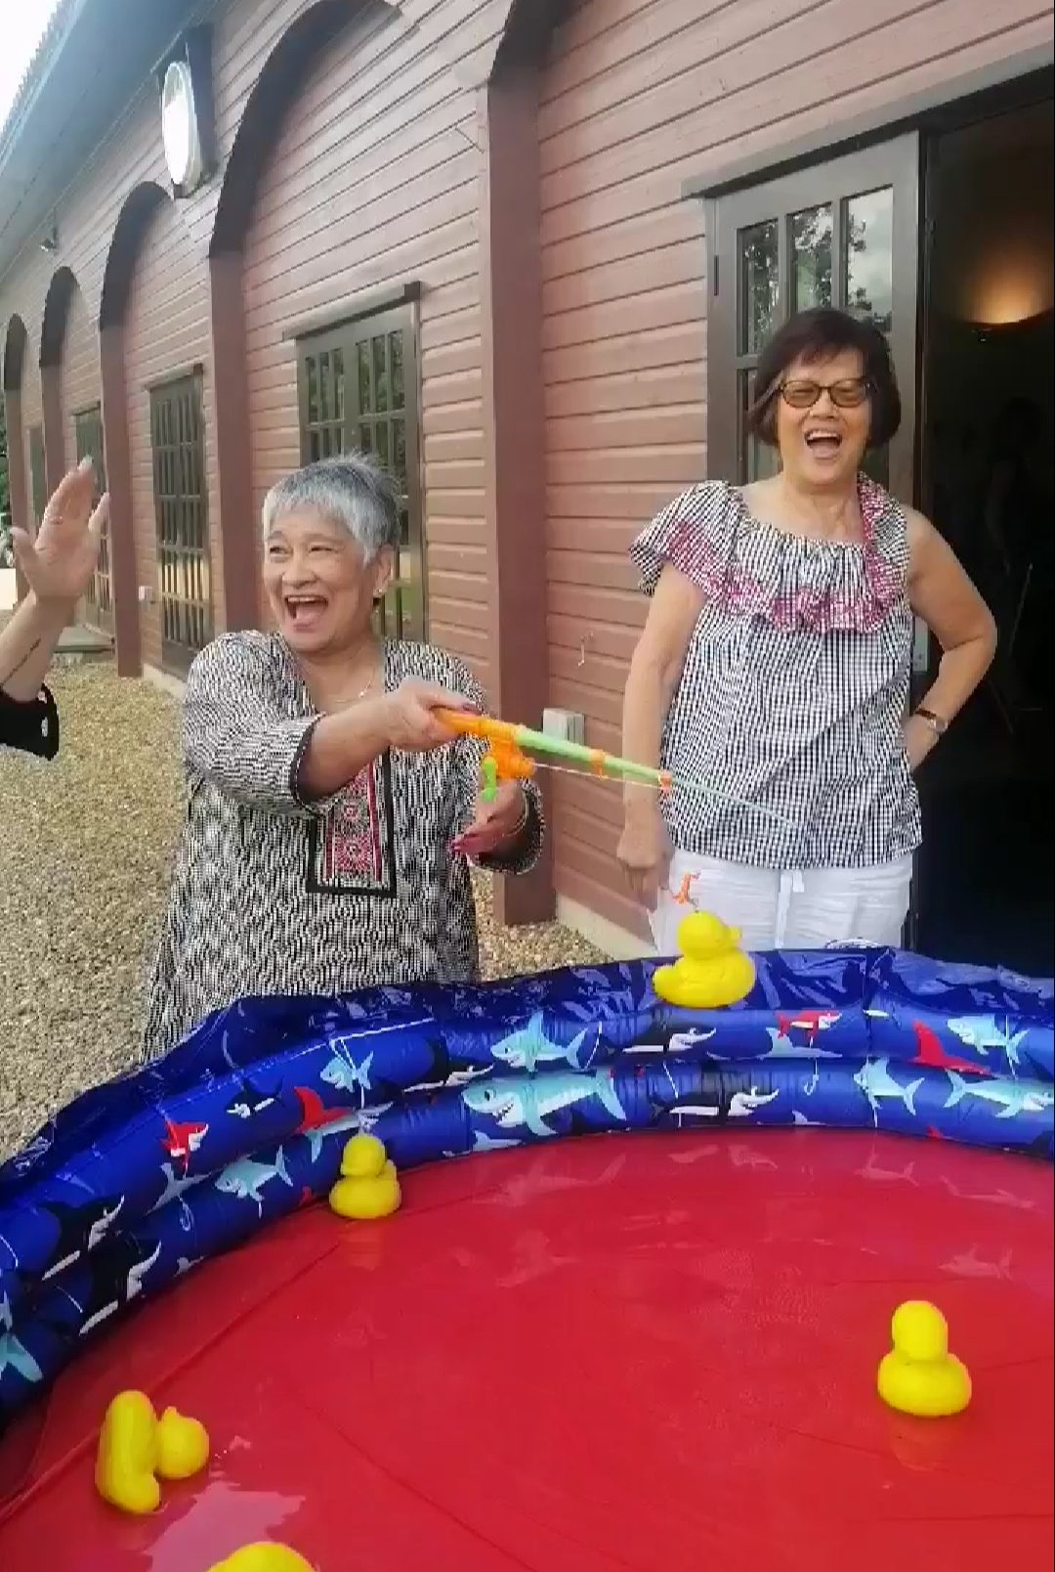
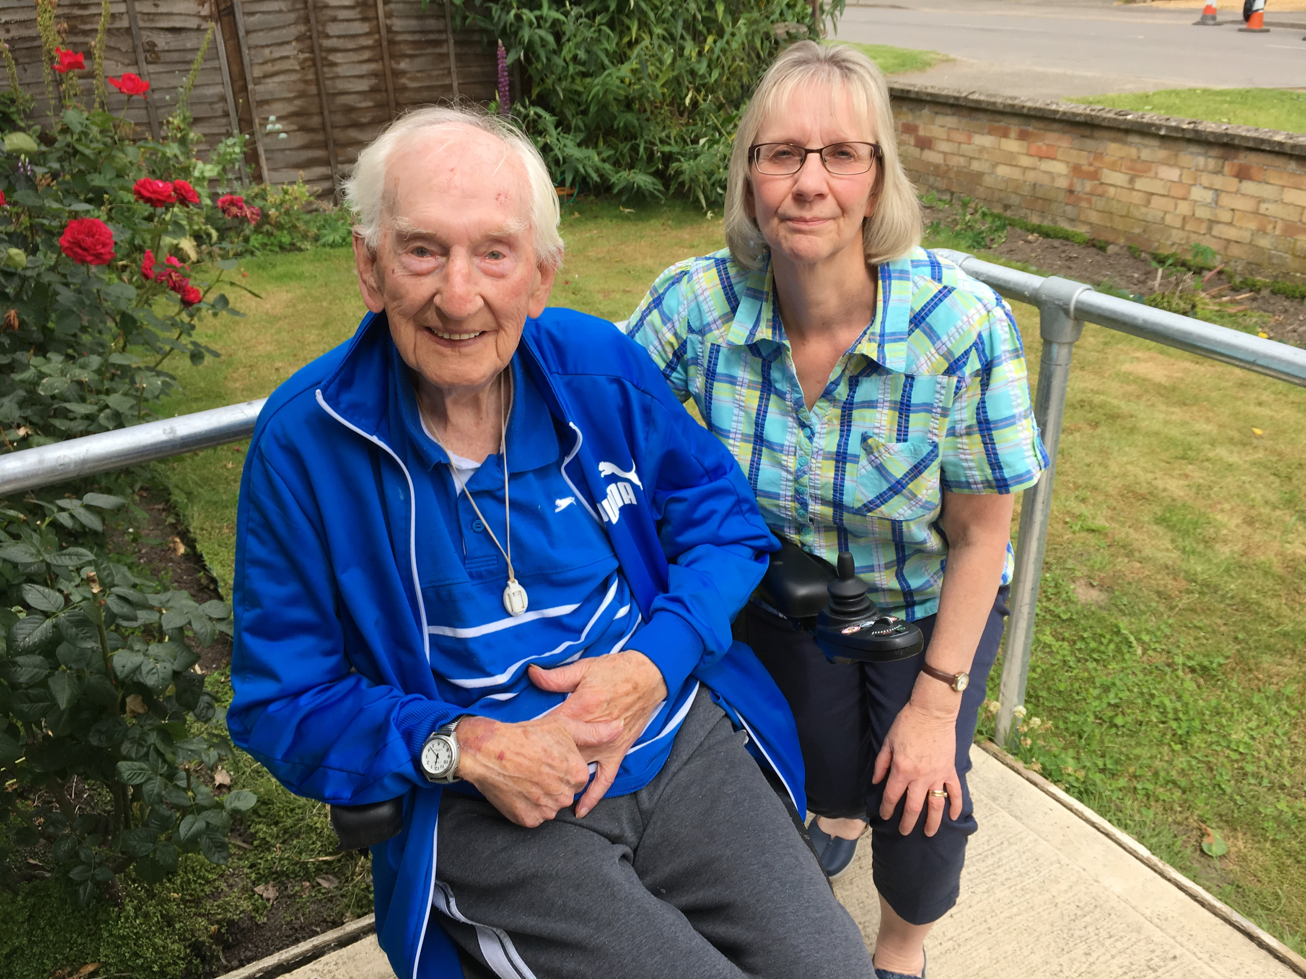
More than 80% of our 500+ volunteers are over 65yrs
Notes:
Here are some of our some of our volunteers who between them have clocked a great many years with Age UK.
We are keen to expand our intergenerational connections too.

Slide 10
Contact Melanie Wicklen:
01354 691895 / 07538 792909
melanie.wicklen@ageukcap.org.uk
www.ageukcap.org.uk
Registered charity number 1165856
Notes:
Thank you for taking the time to listen to this brief overview, there is lots much more that can be covered and I would welcome any questions you may have now or in the future

